Slide 1
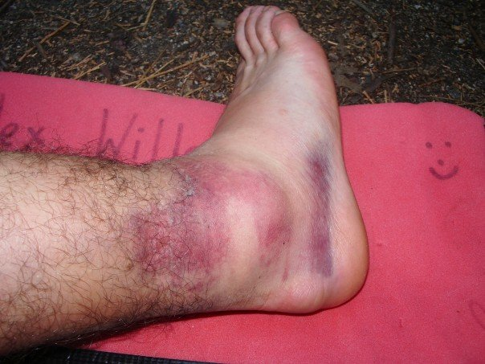
Evaluation of the ANKLE

Slide 2
Evaluation of the ANKLE
HOPS
History
Observation
Palpation
Special Tests

Slide 3
Evaluation of the ANKLE
History
MAPPS
M = Mechanism of injury
A = Acute or chronic
P = Previous history of injury
P = Pain (type & location)
S = Sounds heard or felt at the time of injury or since

Slide 4
Evaluation of the ANKLE
Observation
Look For:
Swelling
Deformity / dislocation
Discoloration
Bleeding
Break(s) in the skin

Slide 5
Evaluation of the ANKLE
Observation
Look For:
Muscle atrophy
Loss of movement
Is the athlete limping?
Did the athlete need assistance to get up?
Is the athlete protecting the injured extremity?
Compare Bi-Laterally

Slide 6
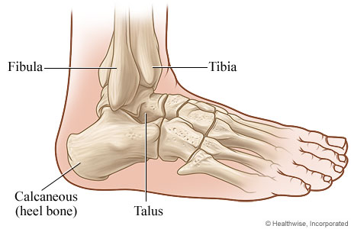
Evaluation of the ANKLE
Palpation
BLTM
Bony Landmarks

Slide 7
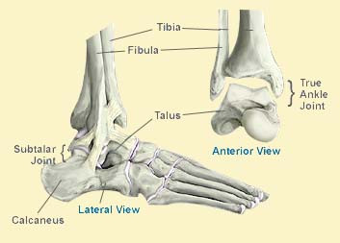
Bony Landmarks
Medial & Lateral Malleolus
Base of 5th Metatarsal
Distal Fibula
Medial Talus

Slide 8
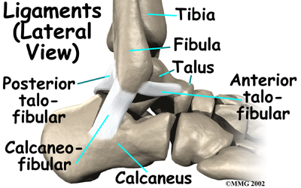
Lateral Ligaments
Anterior Talofibular Lig.
Calcaneofibular Lig.
Posterior Talofibular Lig.

Slide 9
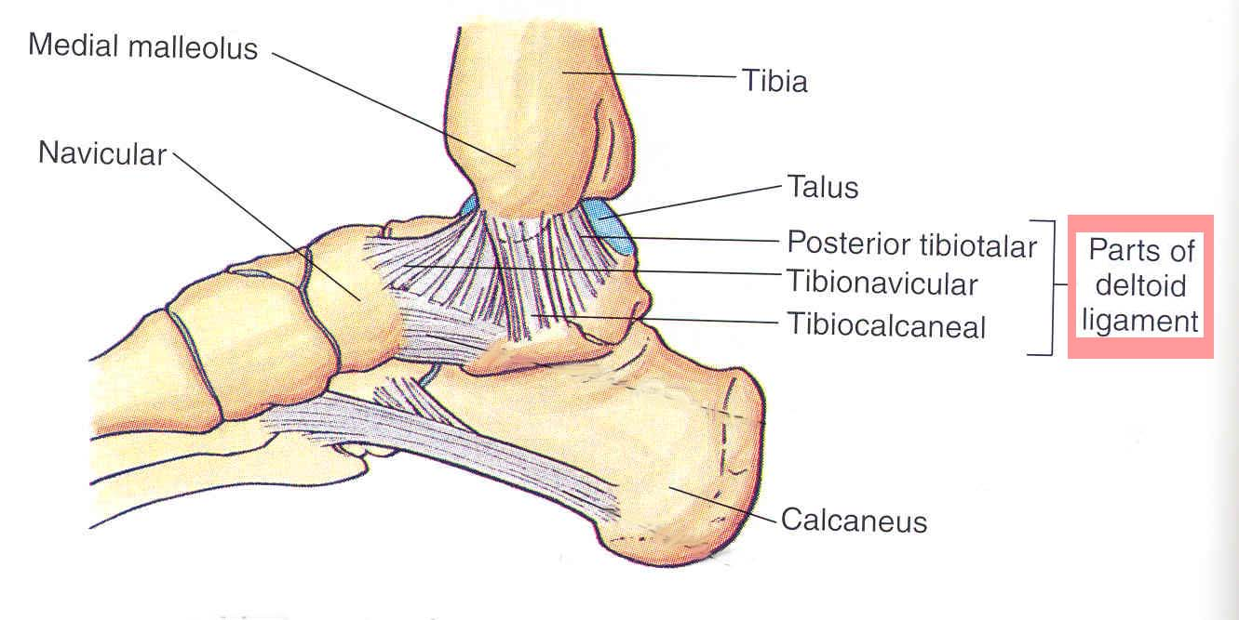
Medial Ligaments
Deltoid Ligament

Slide 10
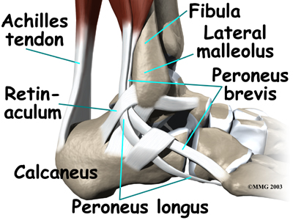
Evaluation of the ANKLE
Tendons, Lateral
Peroneus Longus
Peroneus Brevis

Slide 11
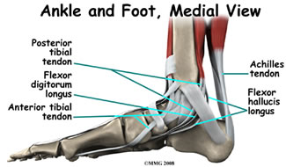
Evaluation of the ANKLE
Tendons, Medial
Posterior Tibialis
Flexor Digitorum Longus
Flexor Hallucis Longus

Slide 12
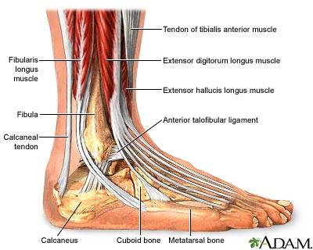
Evaluation of the ANKLE
Muscles

Slide 13
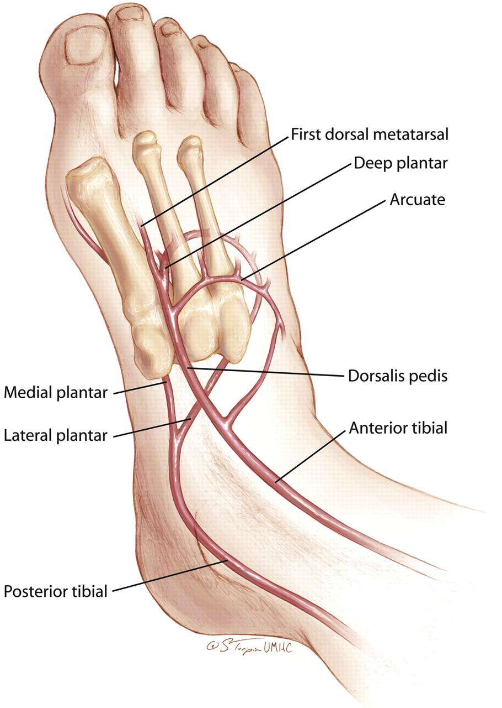
Evaluation of the ANKLE
Pulses:
Dorsal
Pedis
Posterior
Tibial

Slide 14
Evaluation of the ANKLE
Special Tests
ROM
Plantar & Dorsi Flexion
Inversion & Eversion
Active & Passive

Slide 15
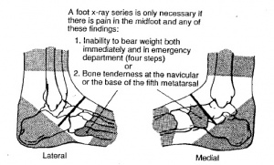
EVALUATION OF THE ANKLE
Ottowa Ankle Rules
Palpate the distal 6 cm of the tibia & fibula, the navicular, & the base of the fifth metatarsal.
Testing for pain & crepitus.
(+) Possible fracture at any of these locations

Slide 16
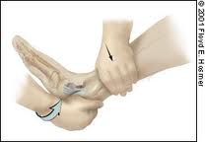
Evaluation of the ANKLE
Anterior Drawer
Tests
Ant. Talo-Fibular Lig Sprain
Patient is seated or supine
Examiner stabilizes the ankle in one hand & uses their dominant hand to firmly pull the foot anteriorly, stressing the ATF ligament, COMPARING BILATERALLY
(+) Result = laxity, pain, crepitus

Slide 17
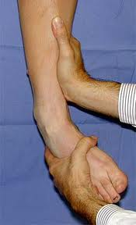
Evaluation of the ANKLE
Talar Tilt
Tests
Calcaneofibular Lig Sprain
Seated or supine
Examiner stabilizes the ankle in one hand, then uses the other to forcefully invert the foot by tilting the calcaneus medially
(+) = laxity, crepitus, pain

Slide 18
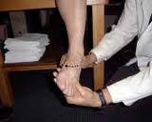
Evaluation of the ANKLE
Eversion Stress Test
Deltoid Ligament

Slide 19
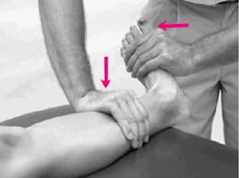
Evaluation of the ANKLE
Kleiger’s Test
External Rotation Test
Deltoid & Ant Tib-Fib Lig
Seated or supine
Stabilizing the ankle in one hand, the examiner uses their dominant hand to fully dorsiflex the foot while externally rotating the ankle
(+) = pain, laxity, inability to perform the test

Slide 20
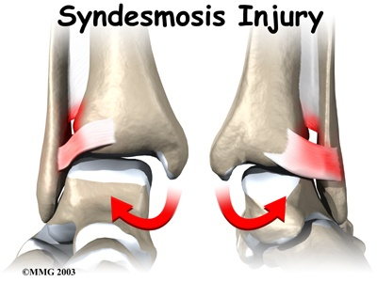
Evaluation of the ANKLE
Kleiger’s Test
External Rotation Test
Deltoid & Ant Tib-Fib Lig

Slide 21
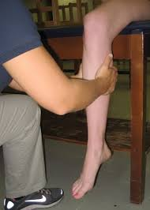
Evaluation of the Ankle
Squeeze Tests
Tib-Fib
Metatarsal
Tests for possible fractures of the fibula or one of the metatarsals

Slide 22
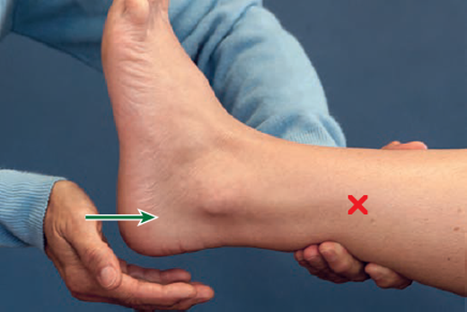
EVALUATION OF THE ANKLE
Bump Test
Tib-Fib
Tarsals, Metatarsals, & Phalanges
Tests for possible fractures at any of these locations

Slide 23
Evaluation of the ankle
Metatarsal Glide Test
Metatarsal bones & connective ligaments
Tests for possible fractures, sprains
DDx: metatarsalgia
Seated or supine; firmly grasp the foot on the plantar & dorsal surfaces of two metatarsals—next to each other—and shift up & down, gliding the bones against each other.
(+) = pain, crepitus, excessive movement

Slide 25
Evaluation of the Ankle
Tuning Fork Test
Tests for possible fracture
*ALWAYS REFER!
Seated or supine; START ON THE UNINVOLVED SIDE! Initiate the tuning fork, then place it at various bony landmarks around the ankle, asking the patient constantly about their pain level & sensation. Then, on the injured side, begin on the contralateral aspect of the foot, placing the end of the vibrating tuning fork at landmarks gradually moving closer to the suspected fracture site, again, constantly communicating with the patient.
(+) = pain, apprehension

Slide 26
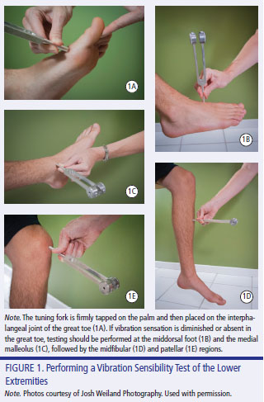

Slide 27
Positive Tests & What they could Mean
Ottowa Ankle Rules – Possible fracture @ any of four points of the ankle
*REFER FOR X-RAY
Anterior Drawer – Anterior Talofibular ligament sprain
Lateral ankle sprain
Talar Tilt (Inversion) – Calcaneofibular ligament sprain
Lateral ankle sprain
Talar Tilt (Eversion) – Deltoid ligament sprain
Medial ankle sprain
Kleiger’s Test – Tibiofibular ligament sprain or deltoid ligament sprain
High or medial ankle sprain

Slide 28
Positive Tests & What they could Mean
Tib-Fib Squeeze Test – Possible fracture of the fibula
*REFER FOR X-RAY
Metatarsal Squeeze Test – Possible fracture of one or more metatarsals
*REFER FOR X-RAY
Bump Test – Possible Fracture of the calcaneus, fibula, tibia, or metatarsals
*REFER FOR X-RAY
Metatarsal Glide Test – Possible fracture or sprain of intertarsal ligament(s)
Tuning Fork Test – Possible fracture @ painful site
*REFER FOR X-RAY

Slide 29
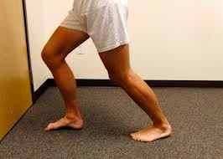
Evaluation of the ANKLE
Functional Tests
Progression!

Slide 30
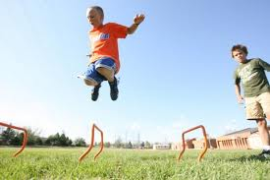
Evaluation of the ANKLE
Functional Tests
Progression!

Slide 31
Evaluation of the ANKLE
Get into groups and work on Ankle Evaluation
We will go through the Power Point again, step by step
Remember
HOPS

Slide 32
WRITE ANOTHER SOAP NOTE! ☺
A female softball player limped into the athletic training room on her left foot. She was walking out to practice when she stepped in a hole & felt immediate pain in her ankle. Right away pain was about a 6/10. After trying to walk on it, it feels more like an 8/10. She doesn’t remember hearing or feeling anything. This is her first left ankle injury before but she has sprained the right one several times. There is no obvious deformity other than swelling on the lateral aspect of her ankle. Her foot is also slightly swollen. She is tender to palpation at the lateral malleolus & around the lateral ligaments. The base of the fifth is tender but not extreme. No pain medially. Pulses are present & intact. She can slightly evert her foot, fully plantarflex, partially dorsiflex, & has no active inversion. She has minimal strength in plantarflexion & dorsiflexion, but inversion & eversion are too painful to perform strength testing. (+) Anterior drawer for pain & laxity (+) Talar tilt eversion for pain at the lateral malleolus (+) Bump test for tenderness at the lateral malleolus (-) Talar tilt inversion/eversion (-) Squeeze Tests

